Slide 1

Suspicious Activity Detection

Slide 2
TEAM MEMBERS
G.LOKESH -
A.KIRAN KUMAR -
CH.GOWRI -
V.HARSHITHA -
D.THULASI -
N190127
N190284
N190327
N190419
N190838

Slide 3
TABLE OF CONTENTS
Abstract
Introduction
Existing systems
Proposed models
Hardware & Software requirements
Dataset collection
YOLO v8 model
Implementation
Challenges
Future Scope
Conclusion

Slide 4
ABSTRACT
The Suspicious Activity Detection System that uses a YOLO Deep Learning model to identify unusual or dangerous actions from CCTV footage. It allows users to login securely using a system built with Flask JWT, and stores user data in a MySQL database. The frontend, built with React, offers a smooth and user-friendly experience. Users can upload full CCTV videos, which are scanned using a YOLO deep learning model to detect suspicious activities like carrying weapons, climbing walls, breaking windows, or moving during odd hours. The system saves and displays the frames where suspicious activity is found. It also supports real-time analysis through live camera integration, sending alerts if any suspicious behavior is detected. This helps reduce the effort of manually watching long videos and enables quick response to potential threats.

Slide 5
INTRODUCTION
In recent years, ensuring public safety has become increasingly important, especially in areas monitored by CCTV cameras. However, manually analyzing hours of video footage is time-consuming and inefficient. To address this, our Suspicious Activity Detection System uses Artificial Intelligence to automatically detect unusual or dangerous actions in surveillance videos. The system is built using Flask for the backend, React for the frontend, and MySQL for data storage. It allows users to log in securely, upload CCTV footage, and view frames where suspicious activities are detected using a trained YOLO model. The goal is to make surveillance smarter, faster, and more responsive, reducing human effort and improving security measures.

Slide 6
EXISTING SYSTEMS
Hikvision – Offers intelligent video surveillance solutions with motion detection and real-time alerts.
Avigilon – Provides AI-powered video analytics and high-definition security cameras.
Dahua Technology – Delivers smart monitoring systems with facial recognition and behavior analysis.

Slide 7
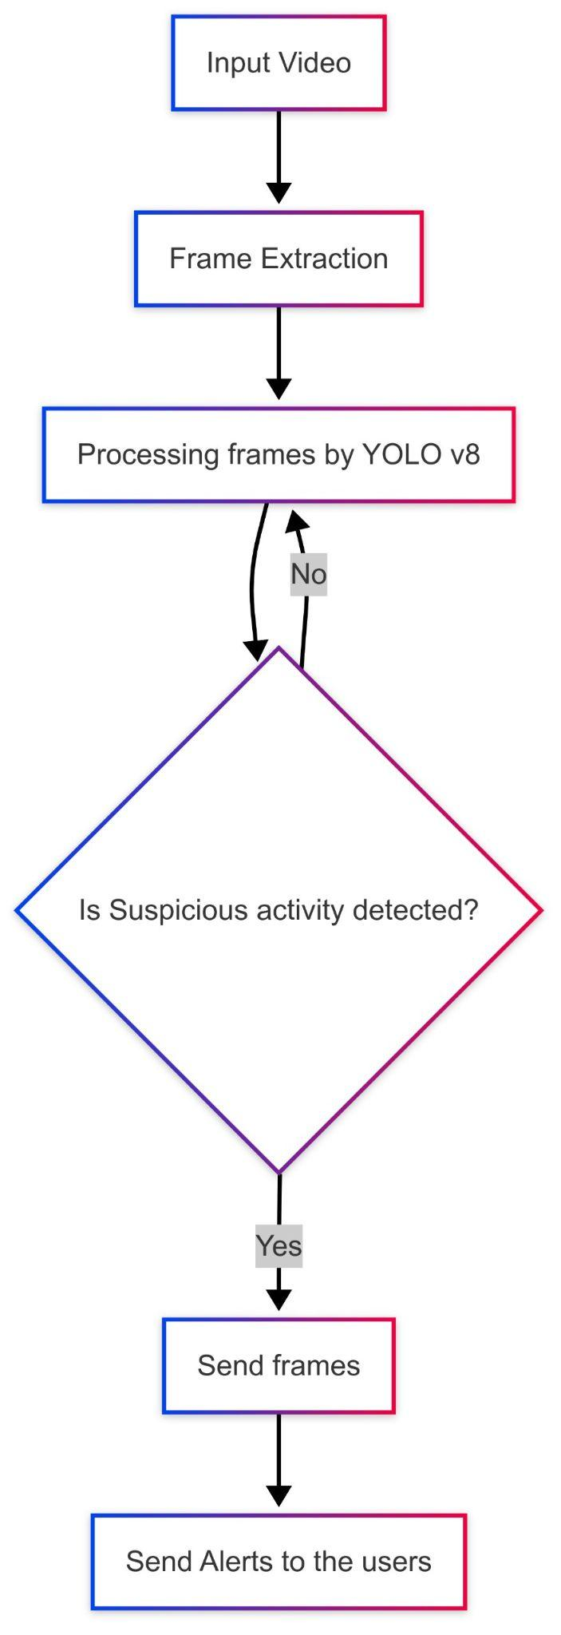
Proposed Model
The proposed model detects suspicious activity in videos by first extracting frames and processing them with YOLO v8 for object detection. If suspicious activity is found, the relevant frames are captured and alerts are sent to users. If no activity is detected, the model continues processing the next frames. This ensures efficient real-time monitoring and prompt alerts.
Fig-1: Proposed Model

Slide 8
Hardware Requirements
GPU (Graphics Processing Unit):
Training: High GPUs suitable for faster model training.
High-Performance CPU:
Intel Core i7/i9 or AMD Ryzen 7/9 series for managing preprocessing tasks and general computation.
RAM:
Minimum 16 GB or higher recommended for handling large datasets

Slide 9
Software Requirements
Libraries:
OpenCV, Flask, React, YOLO
Database:
MySQL
IDE:
Jupyter Notebook or Google Colab for model development
Platforms:
Roboflow, Postman, Redis

Slide 10
Dataset Collection
The dataset for suspicious activity detection is gathered from sources like Kaggle, GitHub, and Roboflow, featuring real-world surveillance scenarios. It includes labeled images for objects such as guns, knives, masks, breaking windows, thief, and people in various suspicious contexts.
These datasets are pre-annotated in YOLO format, making them ideal for training YOLO v8 models efficiently. Roboflow offers preprocessing and augmentation options for working on dataset.

Slide 11
Target Labels of a YOLO V8 Model
The Suspicious Activity Detection is corresponds to YOLO v8 which plays a central role in training the model by providing essential information to the YOLO v8 model about the structure and contents of the dataset.
Target Labels for output:
The dataset consists of seven classes of suspicious activity labels:
Gun, knife, Mask, Person, Thief, Breaking Glass, Climbing Walls.

Slide 12
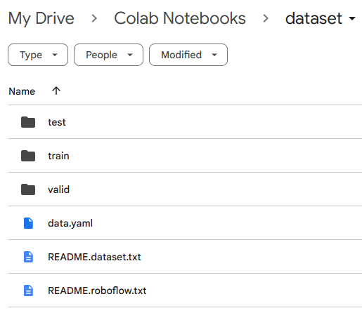
Dataset Folder Structure
This structured approach ensures that the model can effectively learn from well-organized classes during the training phase and accurately evaluate performance during testing and validation phases.
Key Components:
train/: Images and annotations for training.
valid/: Images and annotations for validation.
test/: Images and annotations for testing.
data.yaml: Metadata file with dataset information.
README.dataset: Detailed dataset information.

Slide 13
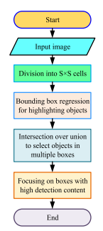
You Only Look Once (YOLO)
It considers real time object detection. The input images are processed by the ConVNNs for features extraction. The fully connected layer reduces the dimensions of the extracted features and obtains a features map and classifies it. The bounding box regression assigns attributes to the classified features. It shows flow chart of the basic YOLO architecture in which an input image is divided into an S × S grid with bounding box regression to identify the objects. The intersection over union operation is then applied to find objects in multiple boxes followed by identifying boxes with high detection content.
Fig-2: YOLO Model

Slide 14
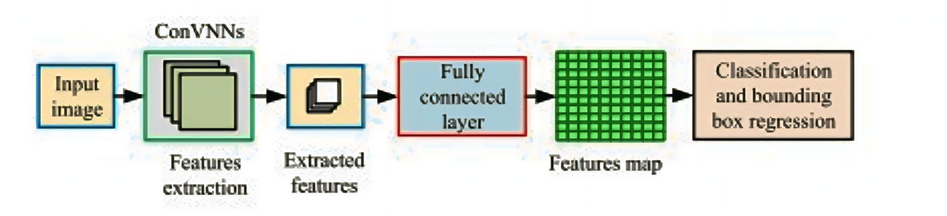
Architecture of YOLO
.
Fig-3: Architecture of YOLO model

Slide 15
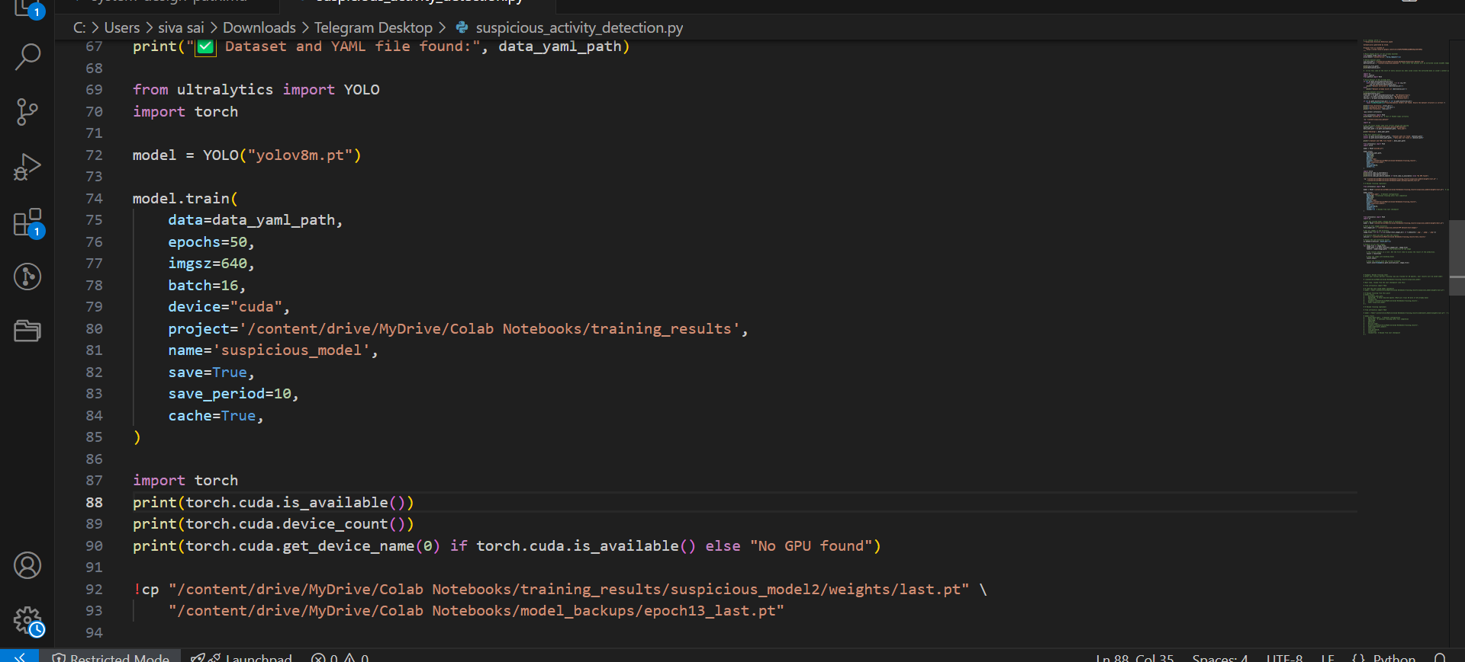
Model Training
.

Slide 16
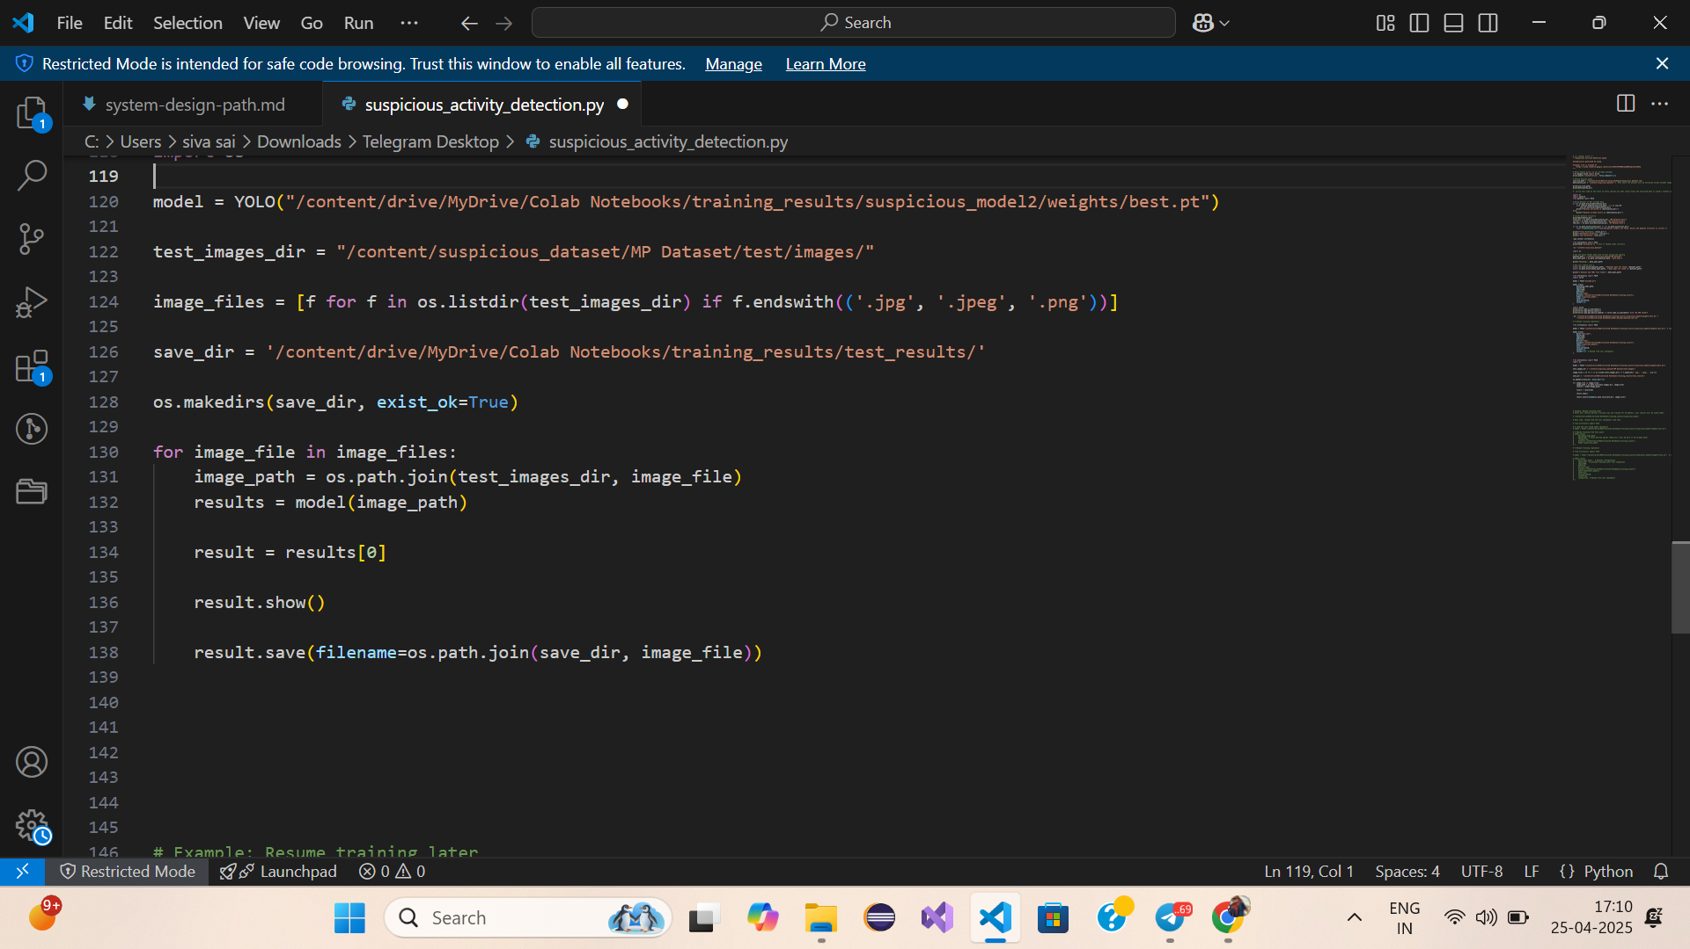
Model Testing

Slide 17
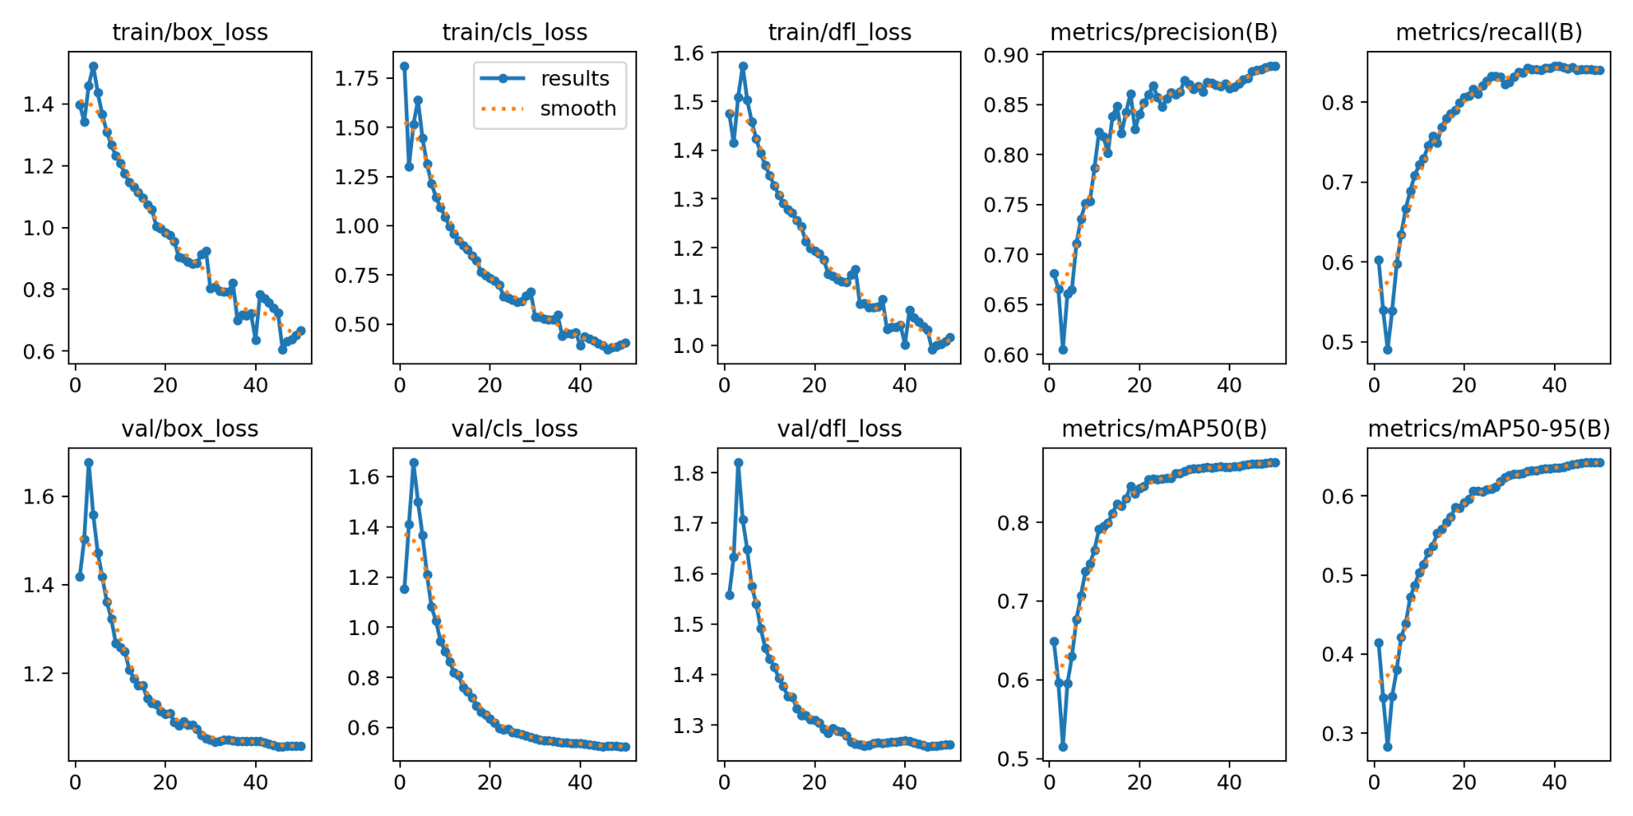
Model Results
Scale: X-axis: 1 unit=20 Y-axis: 1 unit=0.5
Fig-4: Model Training Results

Slide 18
Implementation
The system uses Flask with JWT authentication and MySQL for secure user login and data management.
Uploaded and live CCTV videos are processed using the YOLO deep learning model to detect suspicious activities in real time.
Detected events trigger instant alerts, and frames are displayed on a user-friendly frontend interface using React for monitoring and review.

Slide 19
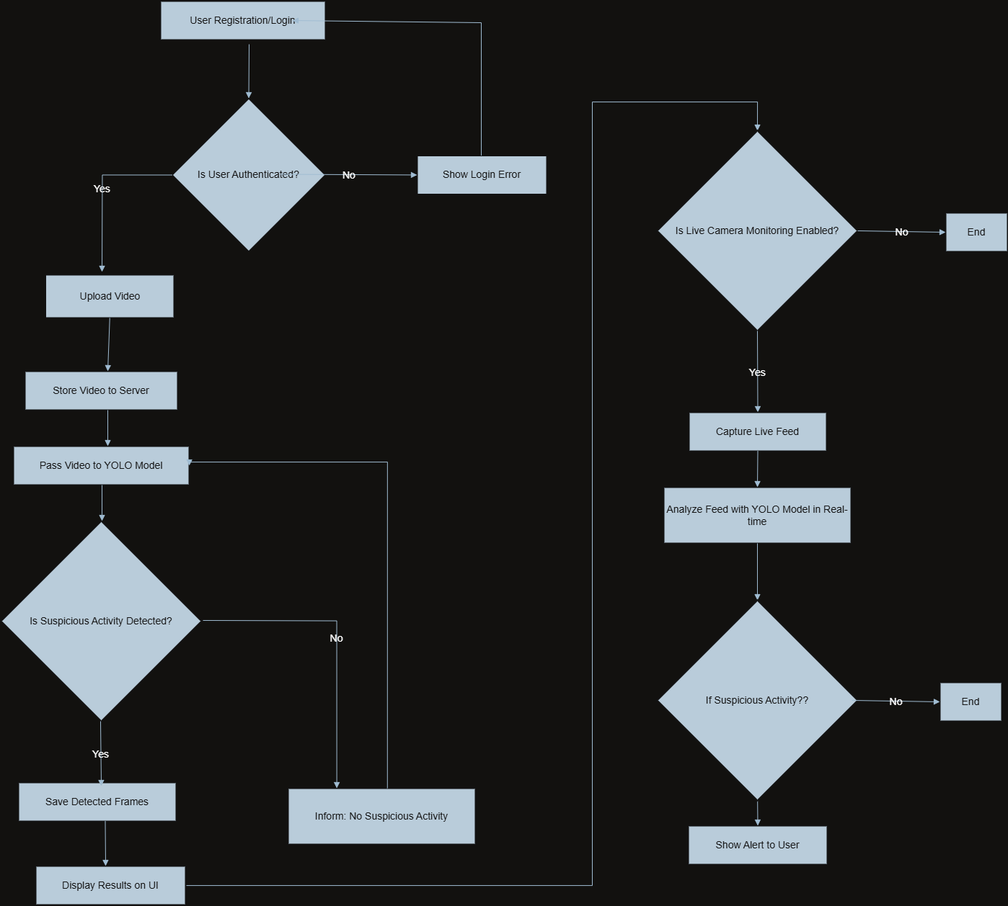
WorkFlow
Fig-5: Project Workflow

Slide 20
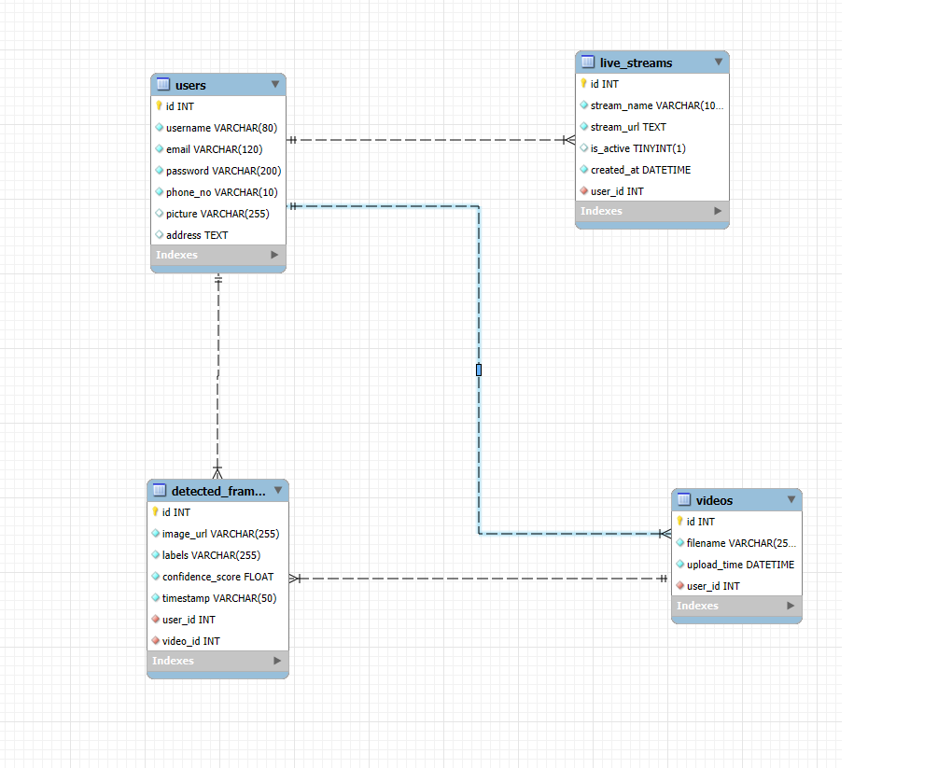
Database
Fig-6: Database Schema

Slide 21
Outputs

Slide 22
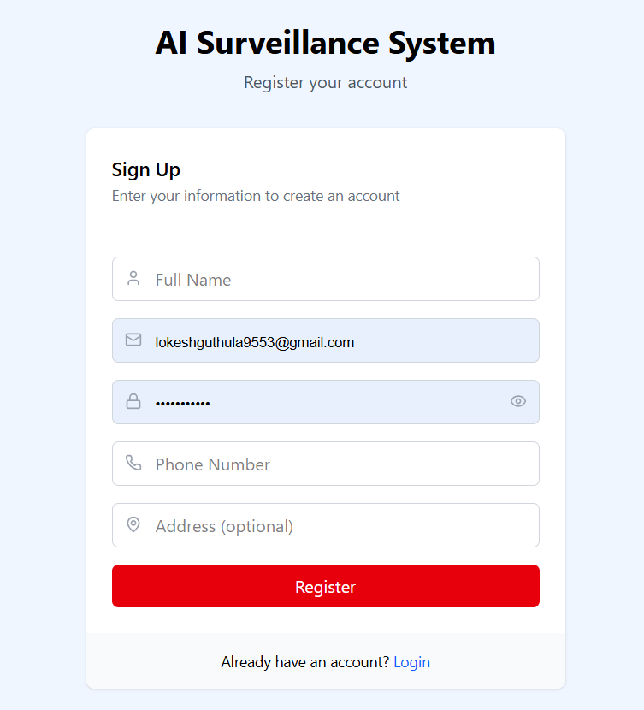
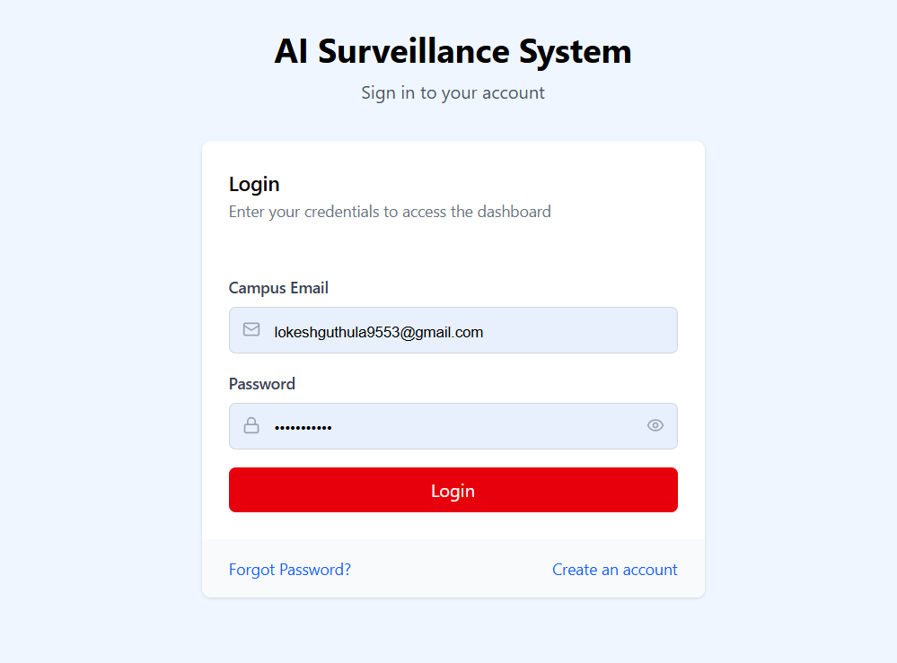

Slide 23
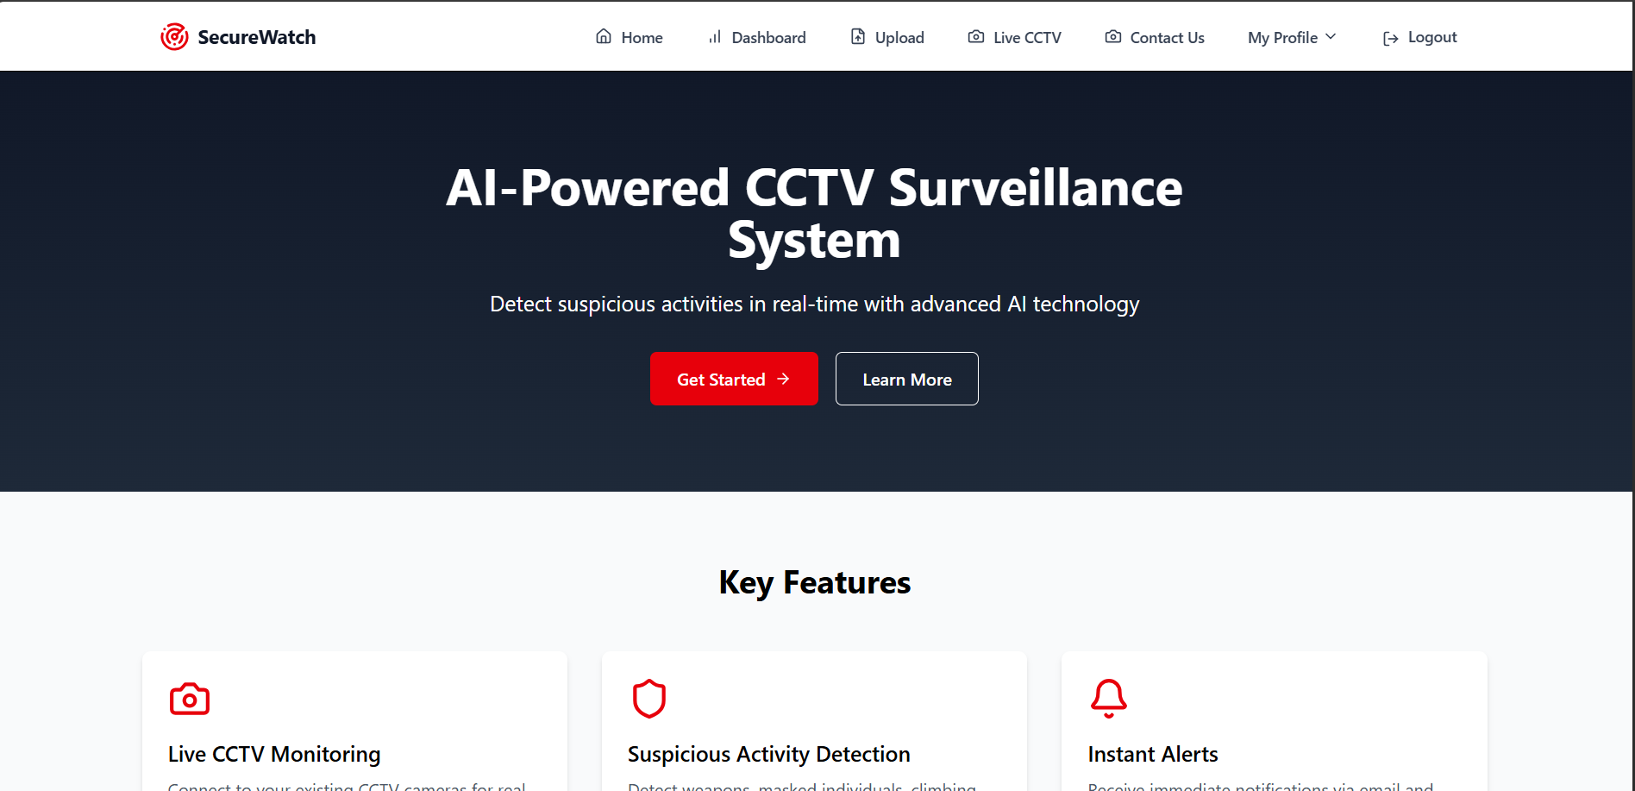

Slide 24
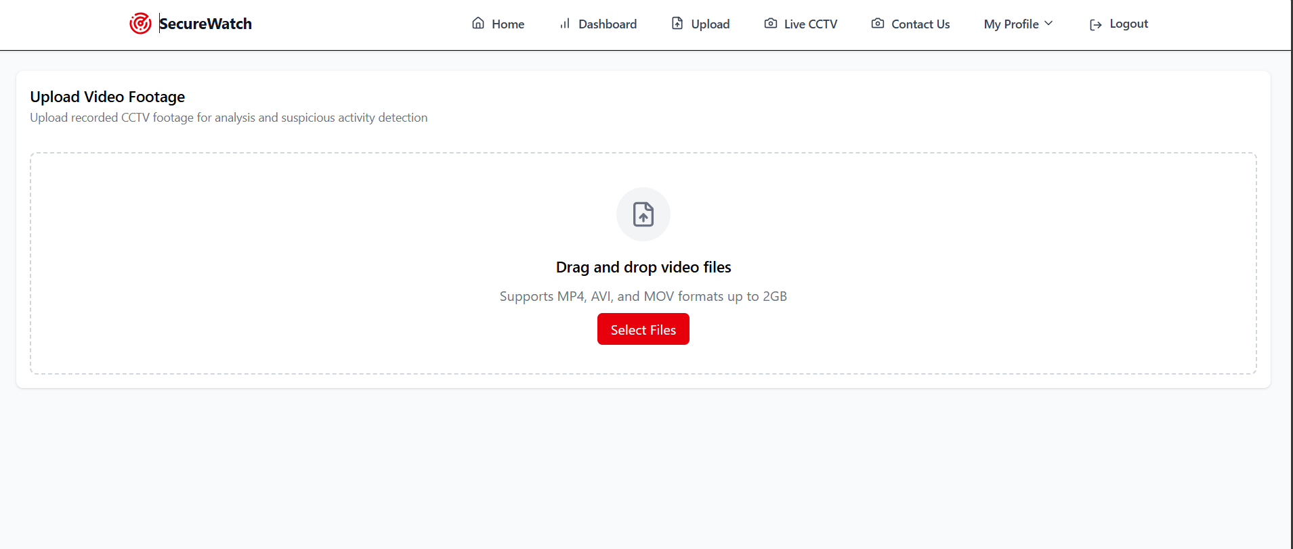

Slide 25
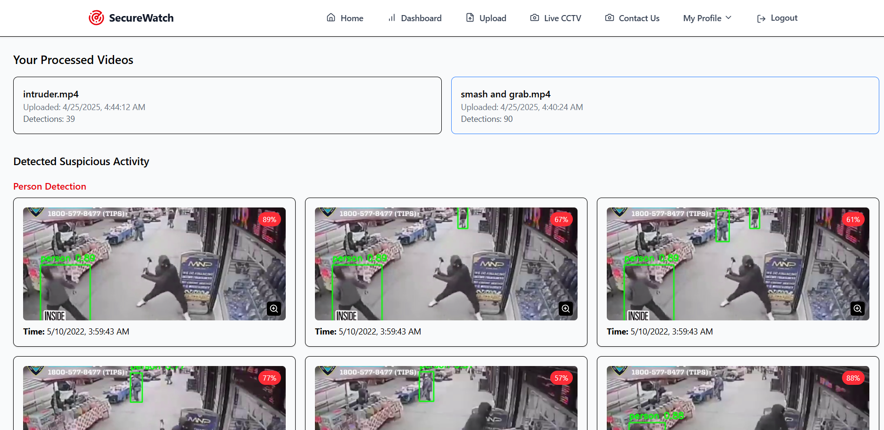

Slide 26
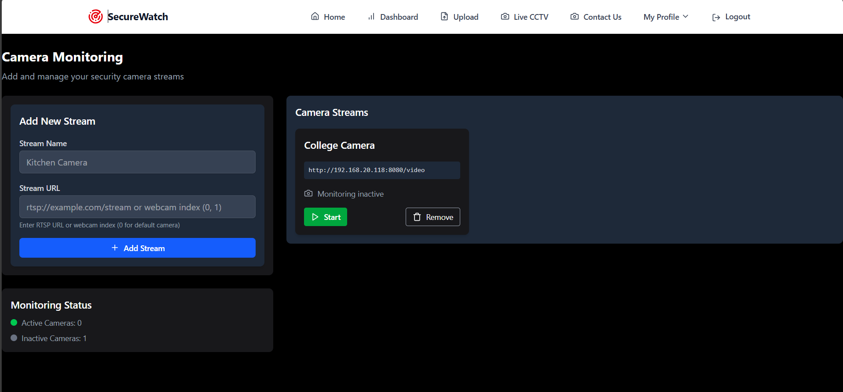

Slide 27
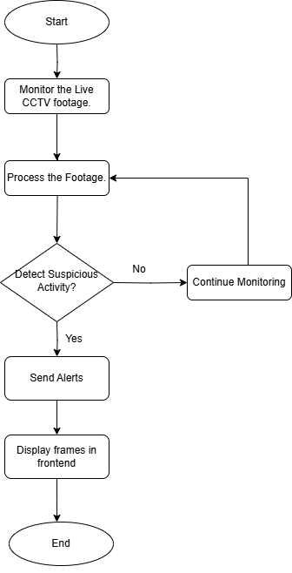
Activity Diagram
This flowchart illustrates a systematic process for detecting suspicious activity, beginning with real-time data collection from surveillance sources such as CCTV cameras or IoT sensors. The incoming data undergoes preprocessing to remove noise and enhance quality. Motion detection and behavior analysis algorithms are then applied to identify unusual patterns. Once flagged, the suspicious activities are validated through cross-checks with historical data or predefined rules. Verified incidents are logged, and alerts are generated for immediate response.
Fig-7: Activity Diagram

Slide 28
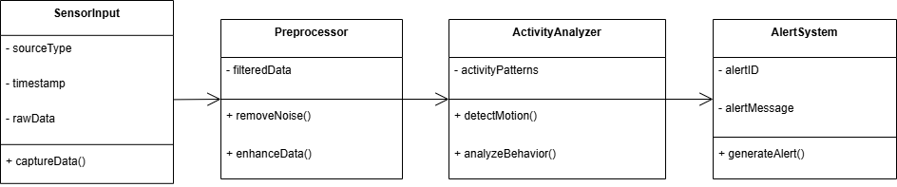
Class Diagram
The Sensor Input class captures real-time data from surveillance devices. This data is then cleaned and enhanced by the Preprocessor class. The Activity analyzer class applies motion detection and behavioral analysis algorithms to identify potentially suspicious actions. Finally, the Alert system class handles alert generation and reporting, enabling timely responses and ensuring the system closes the loop with actionable outputs
Fig-8: Class Diagram

Slide 29
Challenges
Limited Training Data: It’s hard and costly to gather enough underwater images to train models effectively, making it tough for models to work well in all scenarios.
Lack of GPU: Light underwater changes a lot based on depth, water clarity, and artificial lights. Models must handle these variations well.
Noisy Images: Sensors and low light often create noisy or unclear images, which confuse detection systems.
Hidden or Overlapping Objects: Objects can be blocked by other objects or blend into the background, making them tricky to spot.
Lack of Subscriptions: The AWS cloud storage, real-time alerts and GPU access subscriptions are lack.
.

Slide 30
Future Scope
The future scope of this project includes expanding the system to detect a wider range of suspicious activities, such as violence, theft, or unauthorized access. Integrating advanced features like facial recognition and behavior analysis could further improve detection accuracy. Additionally, the system could be scaled to support multiple camera feeds, enabling large-scale surveillance across multiple locations.

Slide 31
Conclusion
The Suspicious Activity Detection System leverages advanced AI techniques to enhance security by automatically identifying potential threats in CCTV footage. By integrating YOLO for object detection and using Flask JWT for secure user authentication, the system offers an efficient and reliable solution for monitoring and responding to suspicious activities. The ability to analyze both uploaded videos and live feeds in real-time ensures quick action, minimizing the need for manual monitoring and improving overall safety. This project demonstrates the power of AI in real-world security applications, making it easier to spot and address potential dangers promptly.

Slide 32
THANK YOU

